Slide 1
Hockey clubs in Flanders
Potential locations for new hockey clubs
Friday, November 15, 2019

Slide 2
Problem Statement
Field Hockey is a booming sport in Belgium, with our national hockey team being nr 1 in the world. New clubs are being opened.
How is the distribution of hockey clubs across Flanders? By plotting the Flanders communes and the hockeyclubs, we can visualize where there is potential for starting a new club.
Where there is potential, it’s key the local communes sponsor the investment as it is high cost. An existing sports facility which can be expanded or which can be shared with other sports (e.g. soccer) increases the chance an investment will be made. This analysis will help identifying locations and likely targets.
Target audience is the Belgian hockey federation who is tasked to promote success of national hockey.

Slide 3
Data
Online listing of all hockey clubs in Flanders, including address and number of members.
Online Wikipedia article describing all Flanders communes
Foursquare data describing existing Athletics & Sports venues in areas where a hockey investment could be made

Slide 4
Methodology
Using BeautifulSoup to extract online html data into a pandas dataframe for further analysis
Using geopy to plot communes and hockey clubs on a Flanders map
Visually identify communes with no hockey coverage and with largest distance from existing hockey clubs
Using Foursquare to identify existing sports infrastructure in these target locations

Slide 5
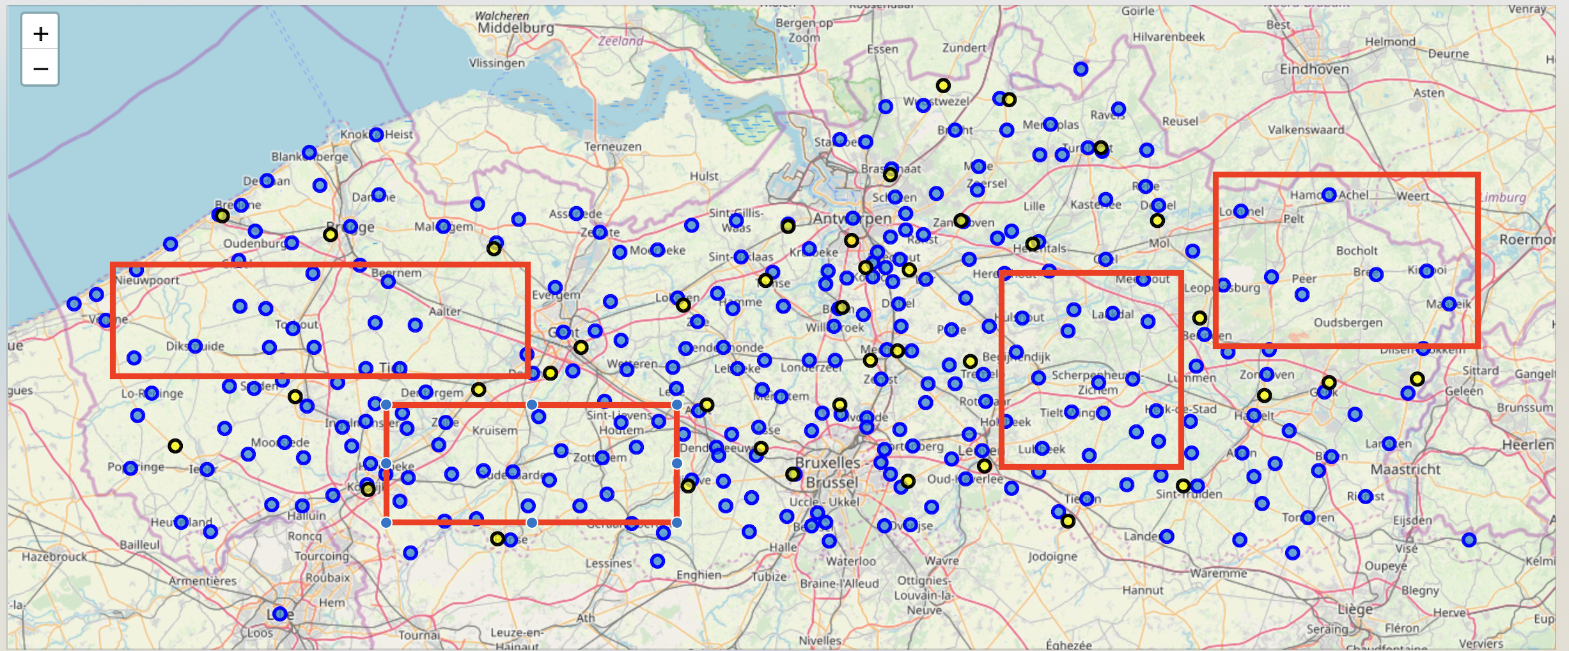
Results
The analysis identifies few areas where there is no hockey coverages in Flanders. Many new clubs have been established or are in process of doing so.

Slide 6
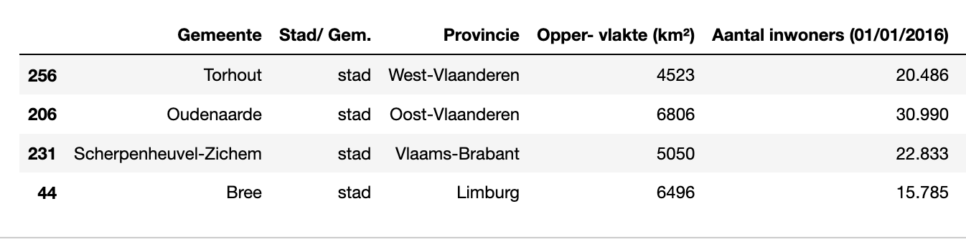
Results
In the middle of each of these areas there is a centrally located city/commune. More details here.

Slide 7
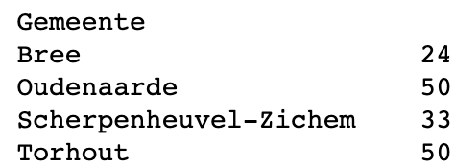
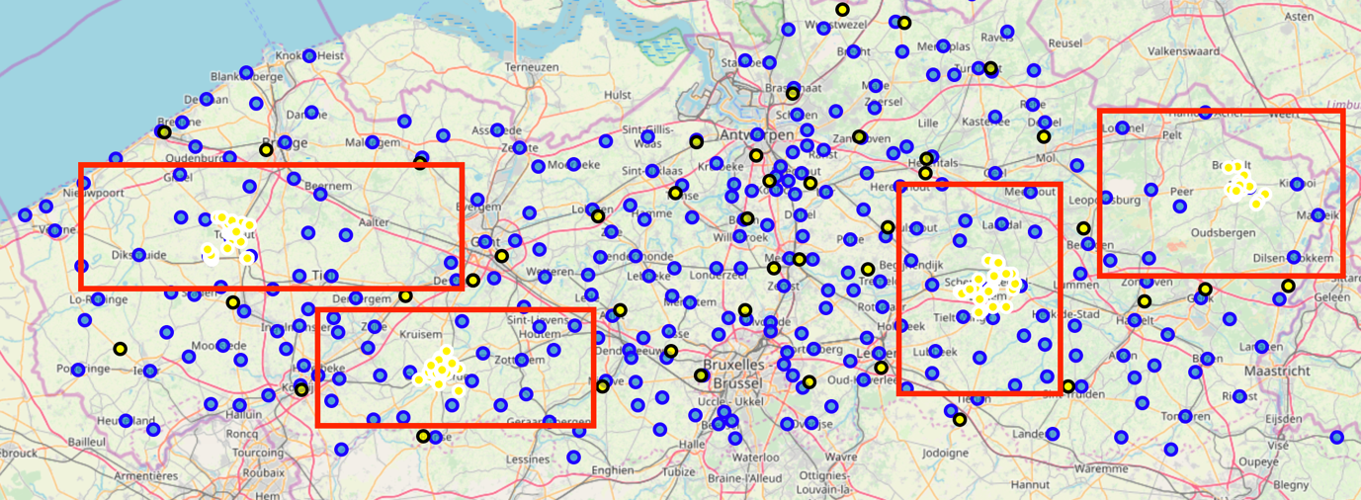
Results
Using Foursquare analysis data, we identify that Torhout and Oudenaarde have the largest existing athletics and sports venues.

Slide 8
Conclusion
Flanders is becoming saturated with hockey clubs. There are still areas with no coverage
Amongst the 4 communes we identified as being located in an area with no hockey presence, there are 2 which stand out being in an area with the most sports infrastructure. Oudenaarde and Torhout.
These communes would be worth additional investigation to determine if a new hockey club would be beneficial. First choice would be Oudenaarde given the larger population.
Foursquare data should be used with caution, especially when selecting on category. The Athletics and Sport venues also include Sports therapists. This can be argued and would not benefit this analysis which primarily needed outdoor sports venues.
As the sports is still booming, a deeper analysis will be required to see if additional clubs could thrive

